Slide 1
Penerapan Algoritma Apriori Untuk Menentukan Pola Penjualan Pada 212 Mart Cibitung

Slide 2
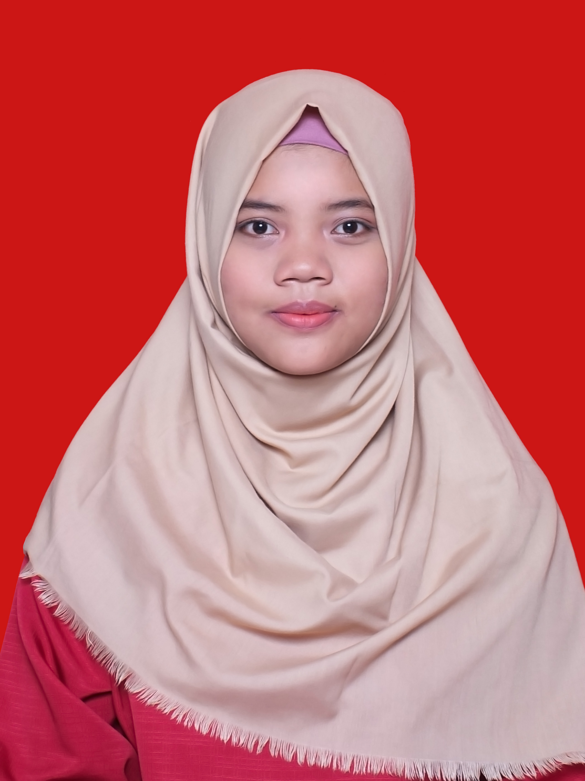
Perkenalkan
Saya Mila Aprilliyani
2015320007
Sistem Informasi
Alamat E-mail:
milaaprilliyani1@gmail.com

Slide 3




Agenda
Masalah
Hasil
Tujuan
HOW ?
Teknik

Slide 4

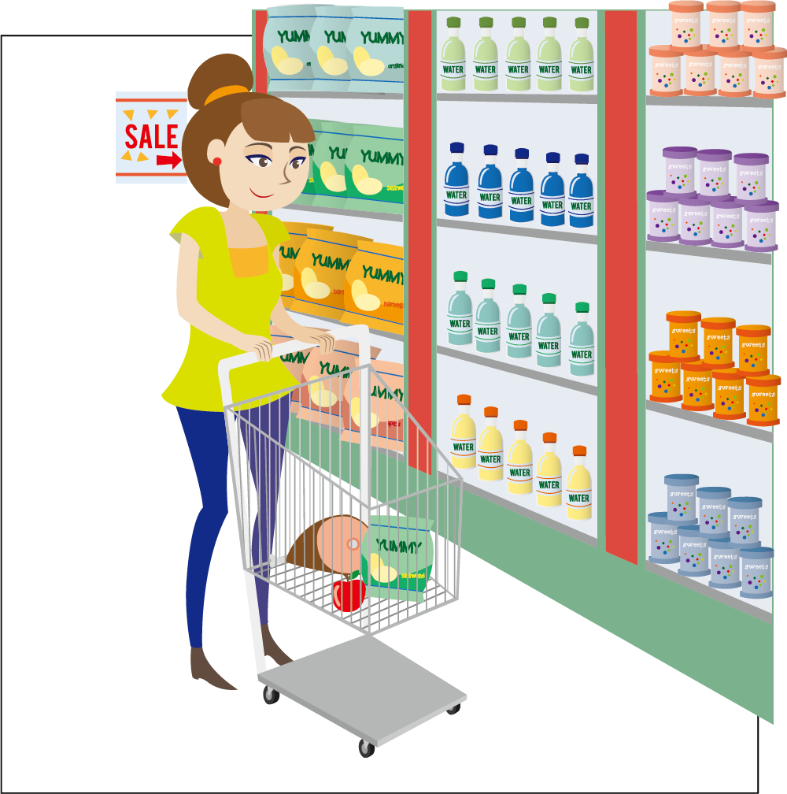
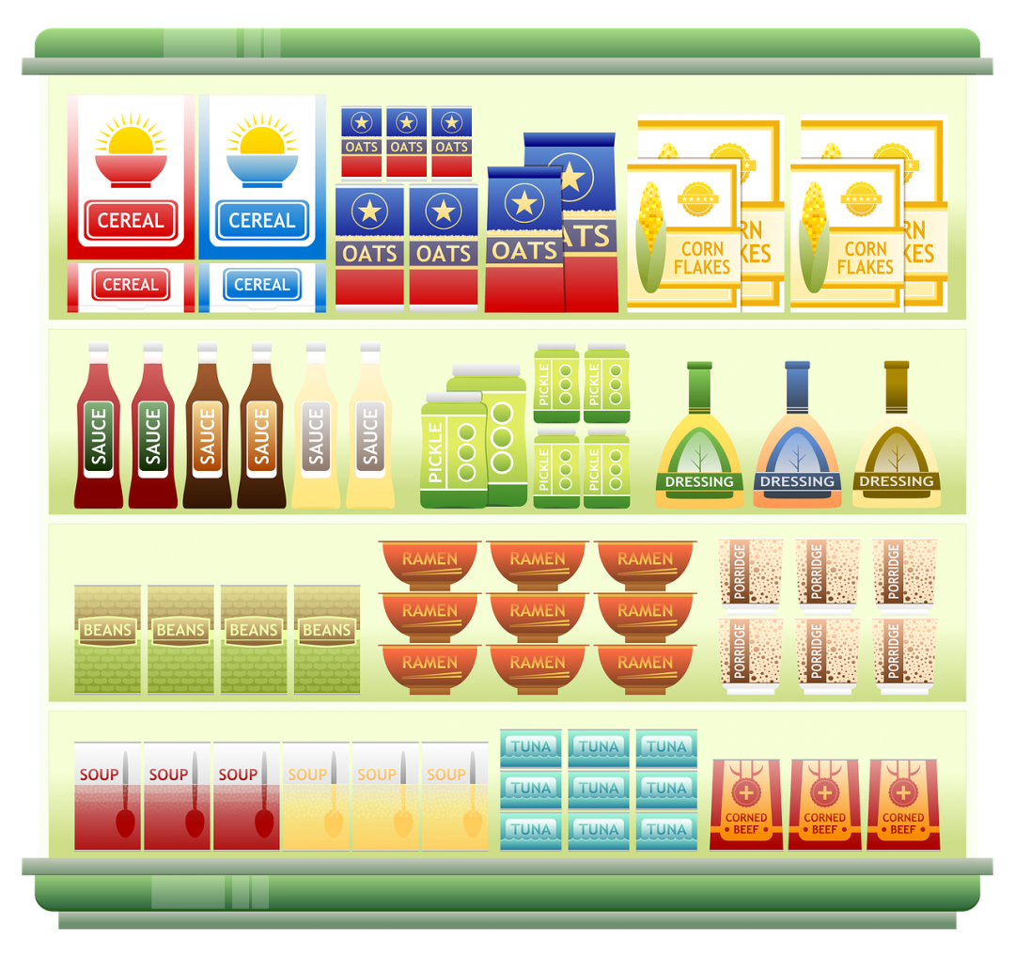
Peletakkan belum sesuai dengan kebiasaan membeli konsumen
Pengaturan tata letak berdasar subjektif kepala toko
Menemukan informasi kombinasi pembelian antar produk

Slide 5




Mengatur tata letak produk sesuai dengan segi pola belanja konsumen.
Menemukan kombinasi pembelian antar produk
Menemukan pola penjualan yang ada 212 Mart Cibitung
Membantu dalam melakukan strategi promosi pada 212 Mart Cibitung.

Slide 6
Teknik
Data Mining
Algoritma Apriori

Slide 7
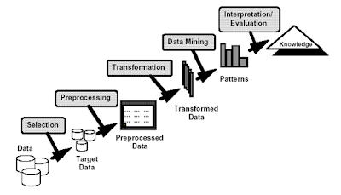
Proses Tahapan Data Mining

Slide 8

Estimasi
Deskripsi
Prediksi
Klasifikasi
Asosiasi
Pengklusteran

Slide 9
Pengaturan Tata Letak
Kombinasi pembelian antar produk
Pola Penjualan
Strategi Pemasaran Pada 212 Mart Cibitung

Slide 10
Let’s review some concepts
Yellow
Is the color of gold, butter and ripe lemons. In the spectrum of visible light, yellow is found between green and orange.
Blue
Is the colour of the clear sky and the deep sea. It is located between violet and green on the optical spectrum.
Red
Is the color of blood, and because of this it has historically been associated with sacrifice, danger and courage.
Yellow
Is the color of gold, butter and ripe lemons. In the spectrum of visible light, yellow is found between green and orange.
Blue
Is the colour of the clear sky and the deep sea. It is located between violet and green on the optical spectrum.
Red
Is the color of blood, and because of this it has historically been associated with sacrifice, danger and courage.

Slide 11
THANKS!
For your Attention
Have a great day

Slide 12
CREDITS
Special thanks to all the people who made and released these awesome resources for free:
Presentation template by SlidesCarnival
Photographs by Unsplash

Slide 13
PRESENTATION DESIGN
This presentations uses the following typographies and colors:
Titles: Montserrat
Body copy: Open Sans
You can download the fonts on these pages:
https://www.fontsquirrel.com/fonts/montserrat
https://www.fontsquirrel.com/fonts/open-sans
Teal (background) #45afdc / Teal (text) #1d98c7
Gold (background) #ed9e46 / Gold (text) #ffc800
You don’t need to keep this slide in your presentation. It’s only here to serve you as a design guide if you need to create new slides or download the fonts to edit the presentation in PowerPoint®

